Slide 1
On the Approximate Realization of Continuous Mappings by Neural Networks article by KEN-ICHI FUNAHASHI presentation by JOSE NARANJO
summary for sections I-II and theorems 1 and 2 from section III

Slide 2
Introduction
Prior to 1988, there had been many studies surrounding the mathematical capabilities of neural networks.
Funahashi committed to prove how complex decision regions can be formed using neural networks with multiple layers.
To do this, he works closely with the studies of Hecht-Nielsen (1987), Kolmogorov (1957) and Irie and Miyake (1988).

Slide 3
Any continuous mapping can be represented through 4 layers
Function realization of several variables could be accomplished through 3 layers, integrals and absolutely integrable output functions (not sigmoid)
Funahashi would come to use both concepts and prove that the approximate realization of continuous mappings by 3 layer (1 hidden) networks whose output functions are sigmoid and whose I/O layers are linear is possible.
Therefore, any continuous mapping can be approximately represented by a feed-forward multilayer (k > 3) network.

Slide 4
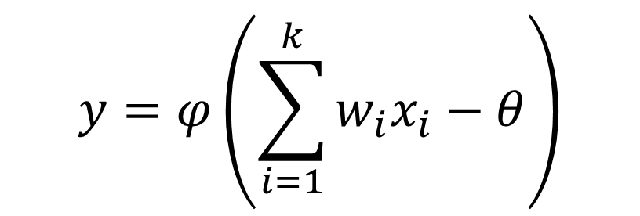
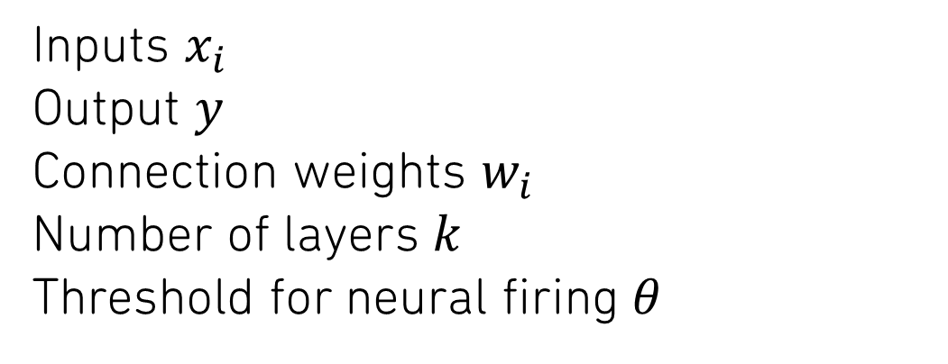
Multilayer neural networks
Inputs $x_{i}$
Output $y$
Connection weights $w_{i}$
Number of layers $k$
Threshold for neural firing $θ$
$$y=φ\left(\sum_{i=1}^{k}{w_{i}x_{i}−θ}\right)$$

Slide 5
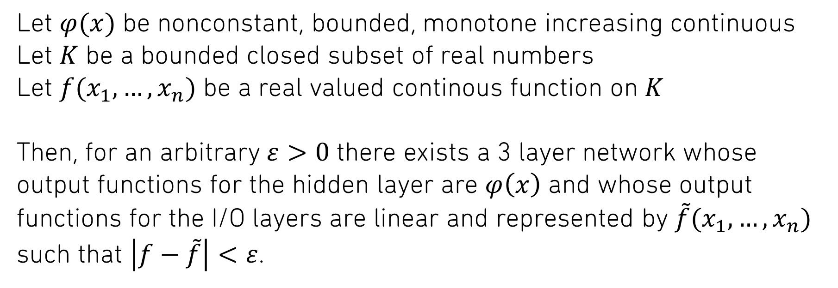
Approximate realization of continuous mappings by neural networks
Let $φ(x)$ be nonconstant, bounded, monotone increasing continuous
Let $K$ be a bounded closed subset of real numbers
Let $f(x_{1},…,x_{n})$ be a real valued continous function on $K$
Then, for an arbitrary $ε>0$ there exists a 3 layer network whose output functions for the hidden layer are $φ\left(x\right)$ and whose output functions for the I/O layers are linear and represented by $\tilde{f}(x_{1},…,x_{n})$ such that $\left|f−\tilde{f}\right|<ε$.

Slide 6
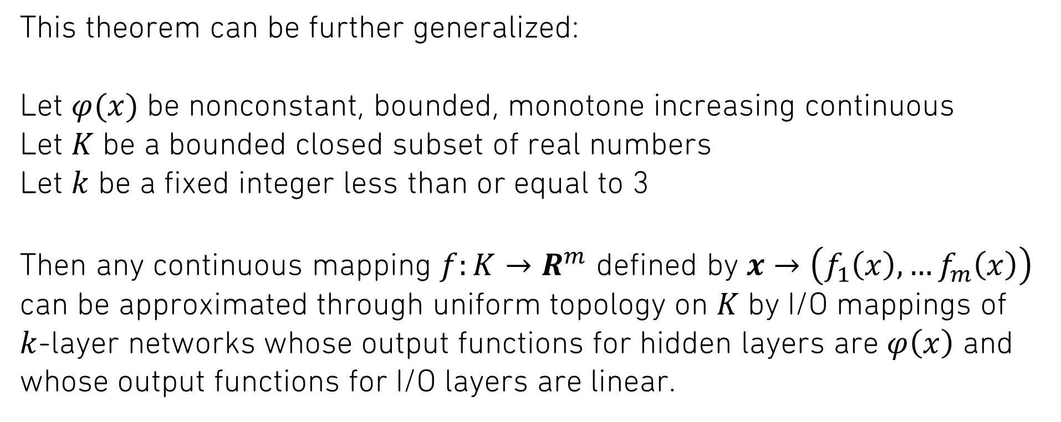
This theorem can be further generalized:
Let $φ(x)$ be nonconstant, bounded, monotone increasing continuous
Let $K$ be a bounded closed subset of real numbers
Let $k$ be a fixed integer less than or equal to 3
Then any continuous mapping $f:K→R^{m}$ defined by $x→\left(f_{1}\left(x\right),…f_{m}\left(x\right)\right)$ can be approximated through uniform topology on $K$ by I/O mappings of $k$-layer networks whose output functions for hidden layers are $φ\left(x\right)$ and whose output functions for I/O layers are linear.

